Slide 1
Restaurant Satisfaction Prediction
6338092621 Tasha Tanarugsachock

Slide 2
Project Description
Purpose
The purpose of this project is to analyze and predict my satisfaction towards the restaurants in order to study my food consumption pattern and restaurant preference
Background
Being an indecisive person, I have always had problems with deciding which restaurant I would like to dine in in each meal. My decision making process can take up to hours before coming into conclusion, yet I may not be satisfied with the restaurant I selected. Moreover, as my family of four always have meals together, choosing restaurant is always a burden since we all want to go to a place that will satisfy all of us. This project is purposely designed to evaluate whether I will be satisfied with the restaurant or not based on the restaurant data and my personal opinion in order to reduce the time wasted to deciding restaurants.

Slide 3
Project Description
Research Scope
This project includes only restaurants that I am familiar with in my regular daily routine. This project does not include restaurant to be chosen on vacation trips.
Research Questions
Food Consumption Pattern Analysis
What cuisine shows the largest number of satisfied and unsatisfied restaurant?
What price range shows the largest number of satisfied and unsatisfied restaurant?
What is the keywords that leads to positive and negative opinion?
Satisfaction Prediction
What factors significantly affect my satisfaction towards a restaurant?

Slide 4
Methodology
Natural Language Processing using 2-Layer-LSTM Model
Opinion is one factor to affect the satisfaction towards the restaurant. However, opinions are in words and cannot be put into a classification model as the input. To resolve this, using the natural language processing (2-layer-LSTM model), opinions can be classified into sentiment – ‘positive’, ‘neutral’, and ‘negative’ which then can be assigned to value of 1, 0, -1 respectively and can be put into a classification model afterwards.
2-layer-LSTM model is the most suitable for the sentiment prediction because of its advantage in memorizing text patterns. Also, its bidirectional wrapper helps with propagating the input in both forward and backward directions providing higher model accuracy.
Logistic Regression Model
In order to show the factors that have large impact on my satisfactory, logistic regression model is used to classify the restaurants into 2 classes – restaurants that will be satisfied and restaurants that will be unsatisfied. Logistic regression method is chosen because its ability to determine the coefficient of each input which is related to the importance of the input on the prediction result. Moreover, the model is used to predict whether I will be satisfied with the restaurant based on the provided data of the restaurant.

Slide 5
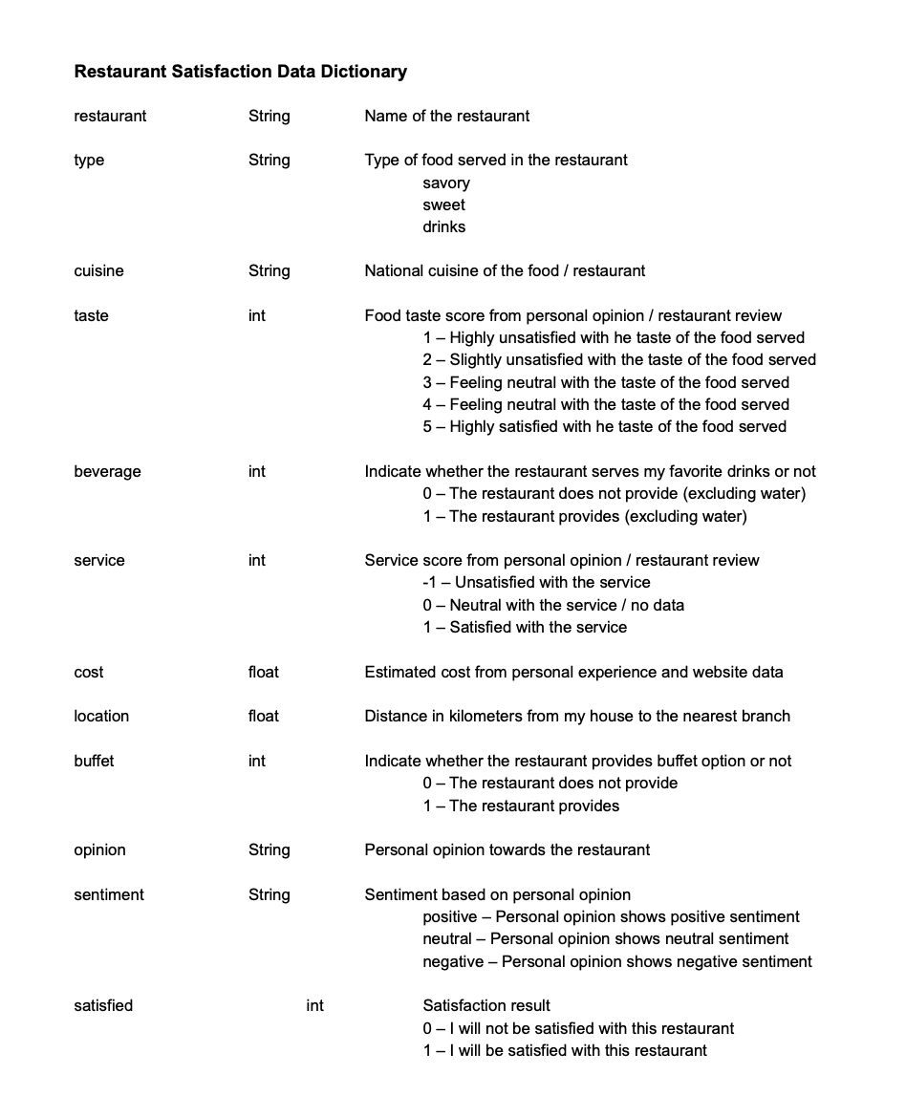
Data Collection
Data is self-collected in April 2022 in excel format
Consist of 12 columns as follows:
Restaurant
Type
Cuisine
Taste
Beverage
Service
Cost
Location
Buffet
Opinion
Sentiment
Satisfied
Restaurant Data : Restaurant Data

Slide 6
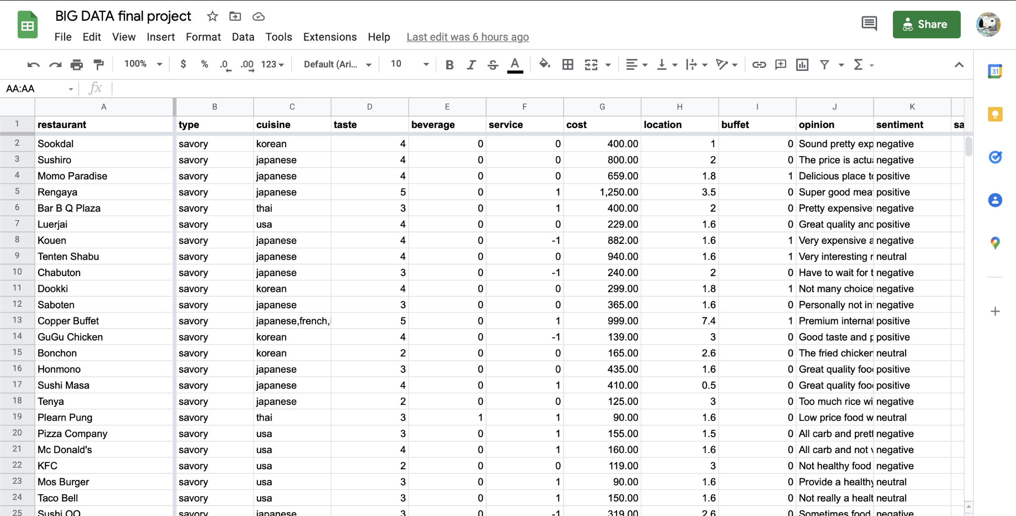
Data Collection

Slide 7
Food Consumption Pattern Analysis
Descriptive Statistics

Slide 8
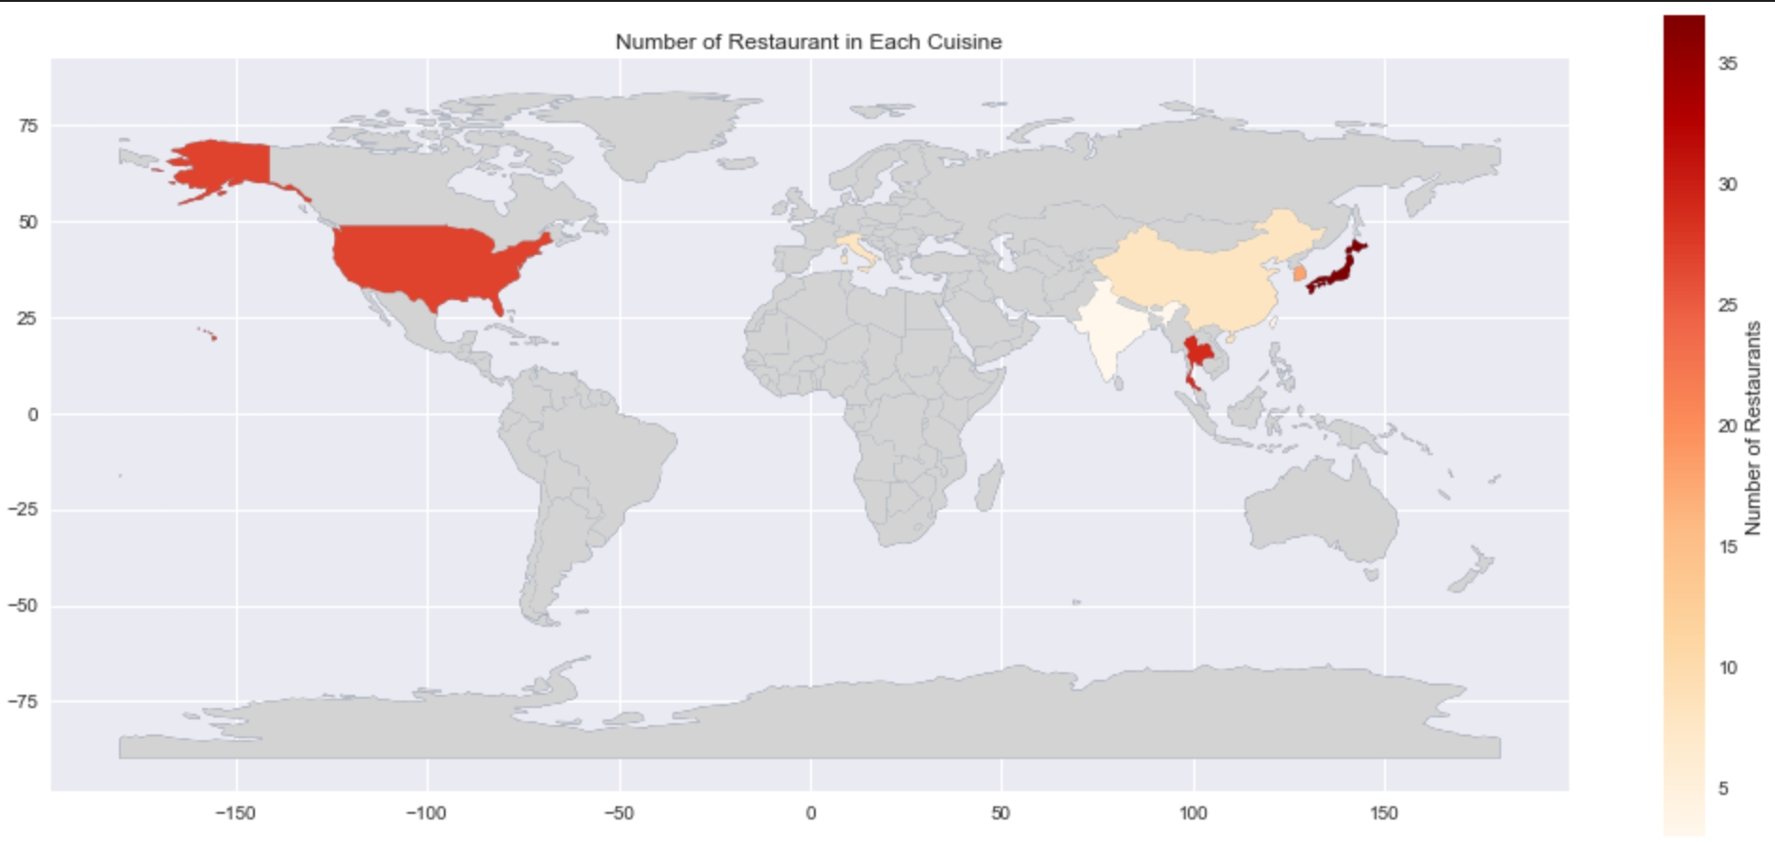
Food Consumption Pattern Analysis
Which cuisine is the most satisfied?
This graph shows that the cuisine with the most number of restaurant is Japanese following with American and Thai

Slide 9
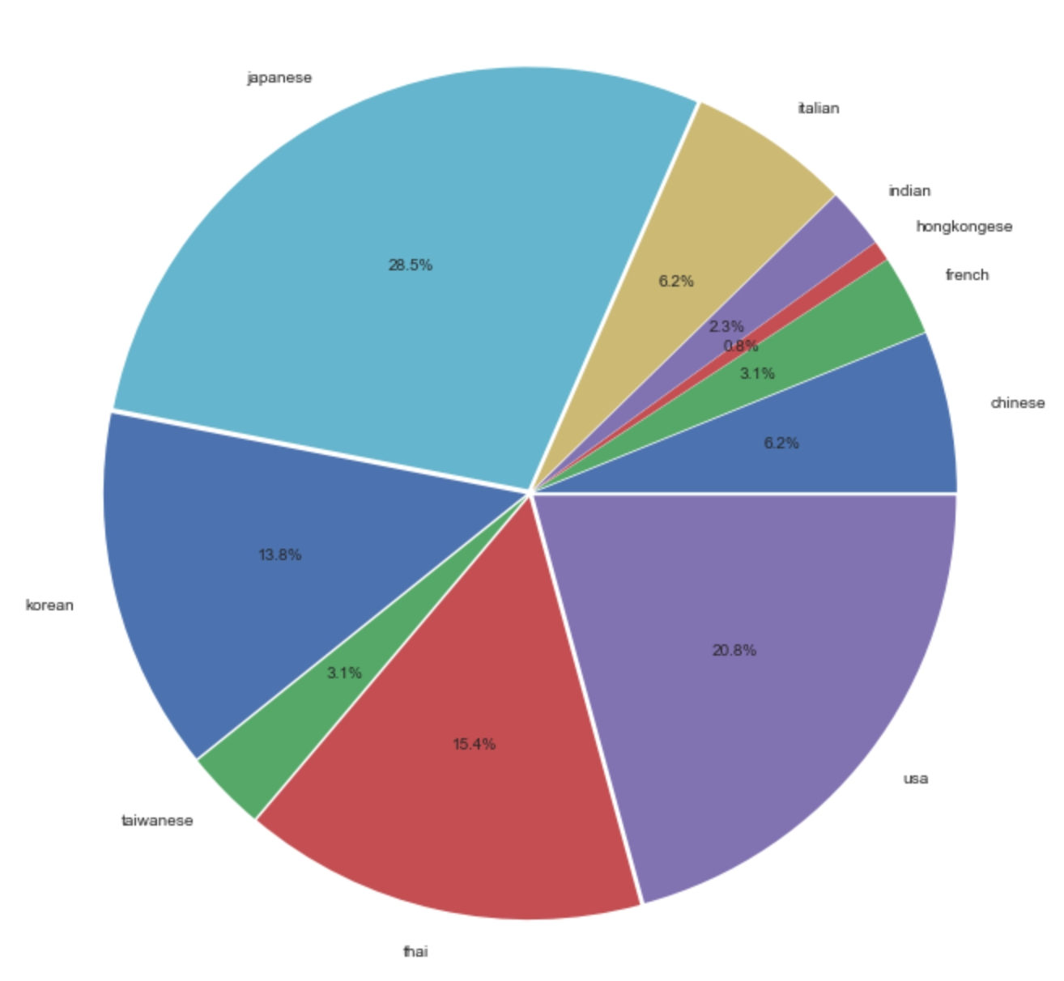
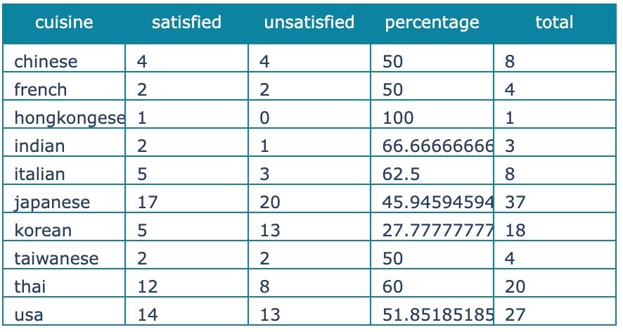
Food Consumption Pattern Analysis
What cuisine shows the largest number of satisfied and unsatisfied restaurant?
Most interested cuisine based on number of restaurants tried
Japanese
American
Thai

Slide 10
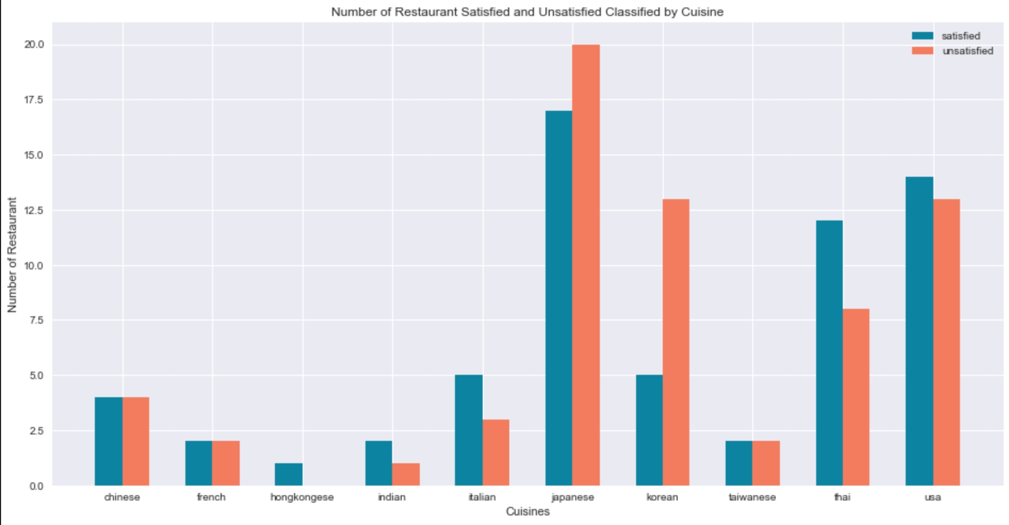
Food Consumption Pattern Analysis
What cuisine shows the largest number of satisfied and unsatisfied restaurant?
As the number of restaurants are imbalance in each cuisine, satisfaction will be determined by the proportion of number of satisfied restaurants to number of unsatisfied restaurants
Conclusion :
Tend to be satisfied with American, Thai, Italian, Indian restaurants
Tend to be unsatisfied with Korean restaurants

Slide 11
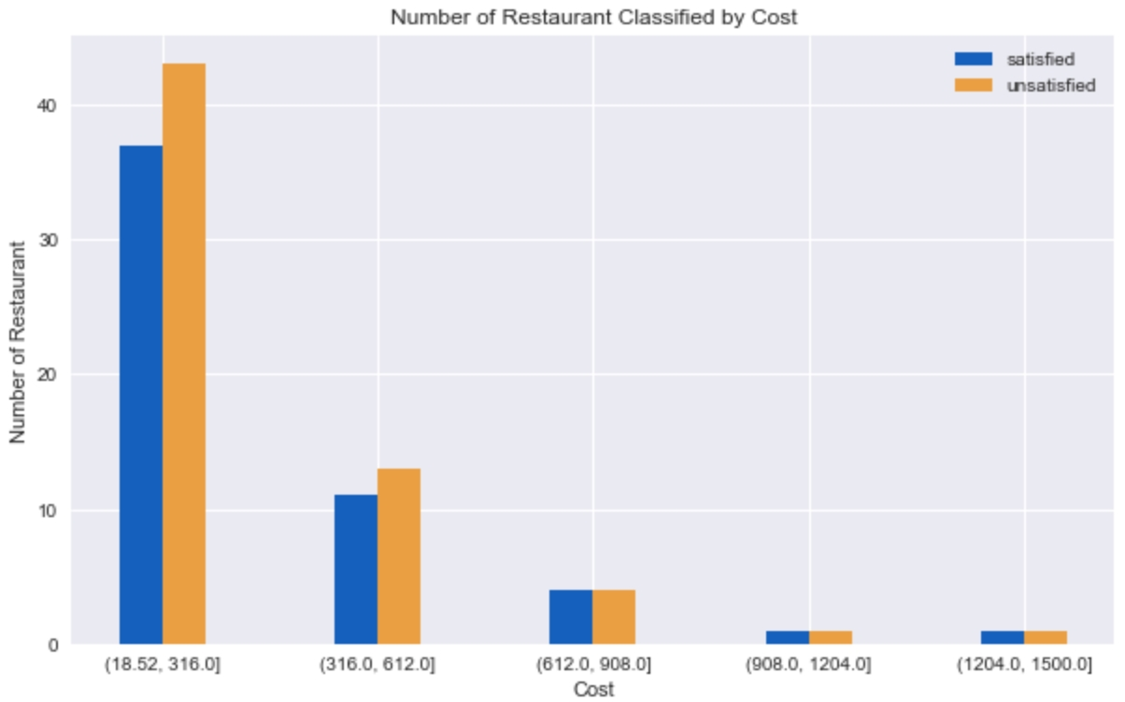
Food Consumption Pattern Analysis
What price range shows the largest number of satisfied and unsatisfied restaurant?
As the number of restaurants are imbalance in each cost range, satisfaction will be determined by the proportion of number of satisfied restaurants to number of unsatisfied restaurants
Conclusion:
Tend to try lower-priced restaurants while tend to be unsatisfied
Do not regularly try higher-priced restaurants while tend to be more satisfied

Slide 12
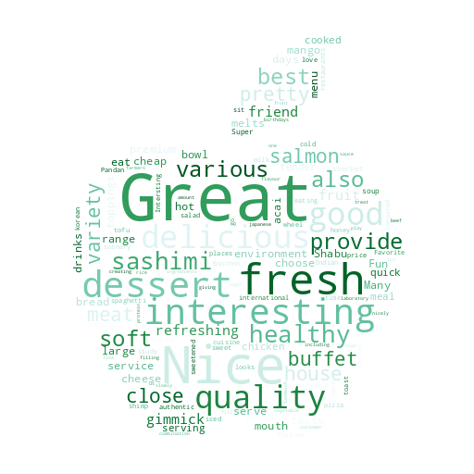
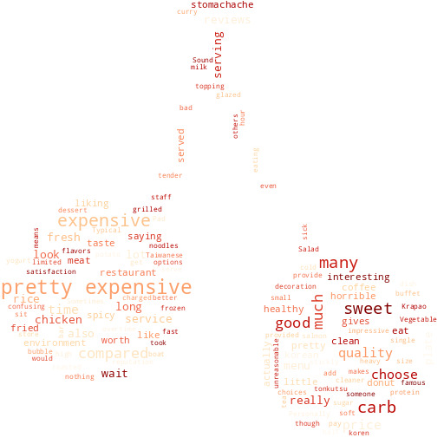
Food Consumption Pattern Analysis
What is the keywords that leads to positive and negative opinion?
Keywords that leads to positive opinion are :
great, nice, fresh, interesting, dessert
Keywords that leads to negative opinion are :
pretty expensive, sweet, carb, expensive, wait

Slide 13
Satisfaction Prediction
Data Analysis

Slide 14
Data Analysis Procedure : Natural Language Processing
Encode opinion from String to numerical value
Predict LSTM model
Start
Input
Restaurant data
Split train data (70%)
and test data (30%)
Output
Confusion matrix
Change sentiment from String values to int (0, 1, 2)
Create 2-layer LSTM model
End
Clean input opinion
Train the LSTM model

Slide 15
Data Analysis Procedure : Logistic Regression
Start
Input
Restaurant data
Check the collinearity in x columns
Predict the logistic regression model
Change categorical data
to numerical data (float)
Drop columns that have high collinearity
Evaluate the logistic regression model accuracy
Split train data (70%)
and test data (30%)
Create logistic regression model
Output
Coefficient of each x column
Normalize x columns that are non-binary
Train the logistic regression model
Output
Confusion matrix
End

Slide 16
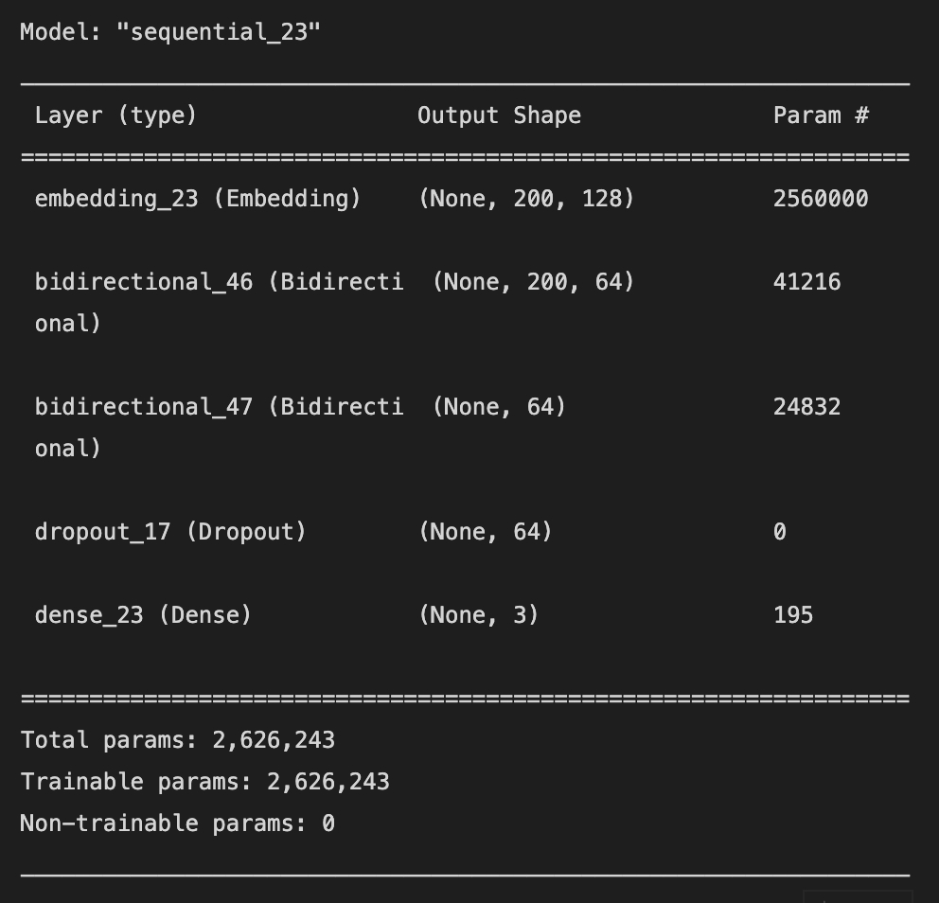
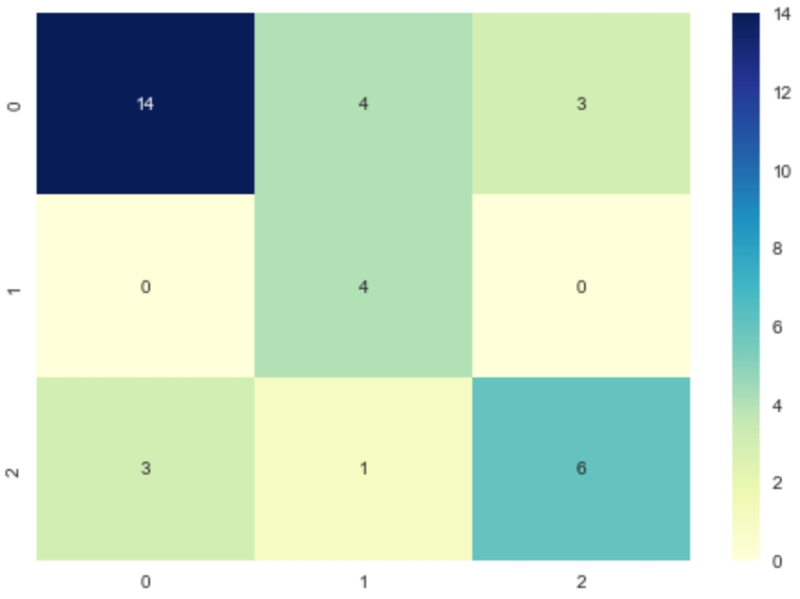
Satisfaction Prediction
What factors significantly affect my satisfaction towards a restaurant?
Natural Language Processing using 2-Layer-LSTM Model
Model used :
Accuracy obtained :
Maximum accuracy of 0.6857
0 – negative 1 – neutral
2 – positive
Sentiment prediction model shows acceptable accuracy of 0.6857.
The model shows higher accuracy in predicting positive and negative opinions but should be improved on predicting neutral opinions.

Slide 17
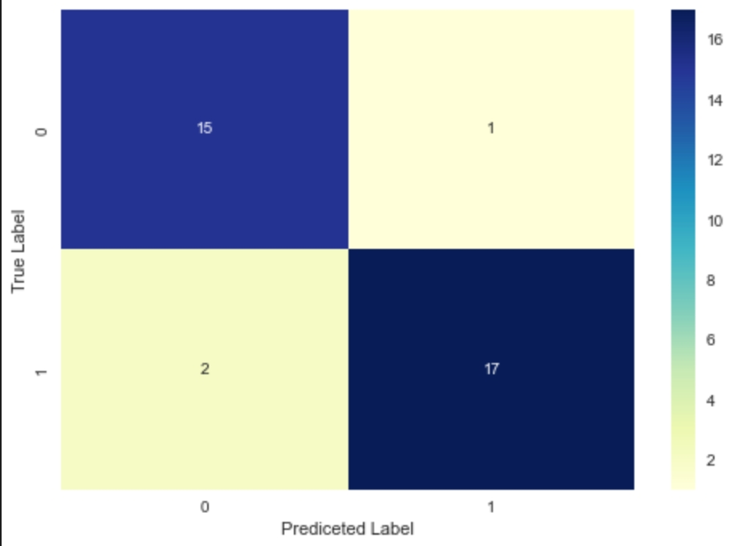
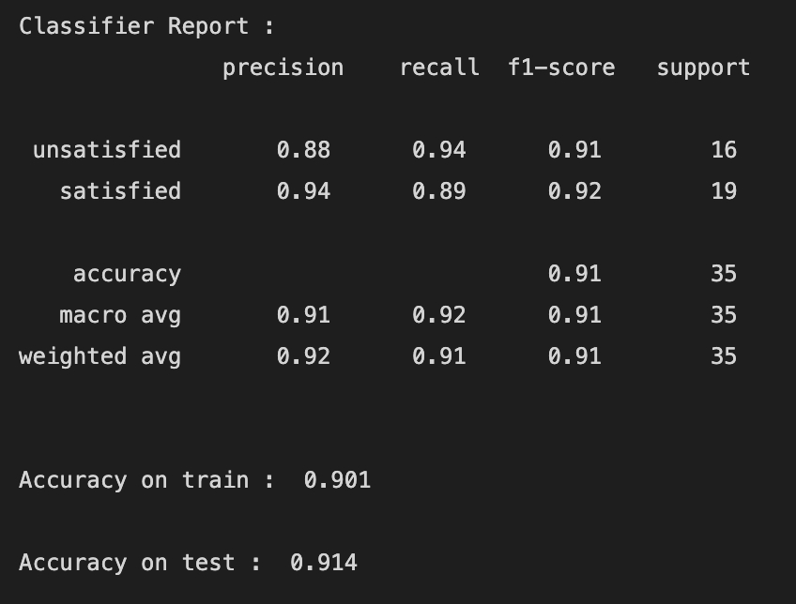
Satisfaction Prediction
What factors significantly affect my satisfaction towards a restaurant?
Logistic Regression Model
Accuracy obtained :
Accuracy on train dataset of 0.901
Accuracy on test dataset of 0.914
Confusion matrix :
0 – unsatisfied 1 – satisfied
Satisfaction prediction model shows great accuracy of 0.914.
The model shows great accuracy in predicting both satisfied and unsatisfied restaurants.

Slide 18
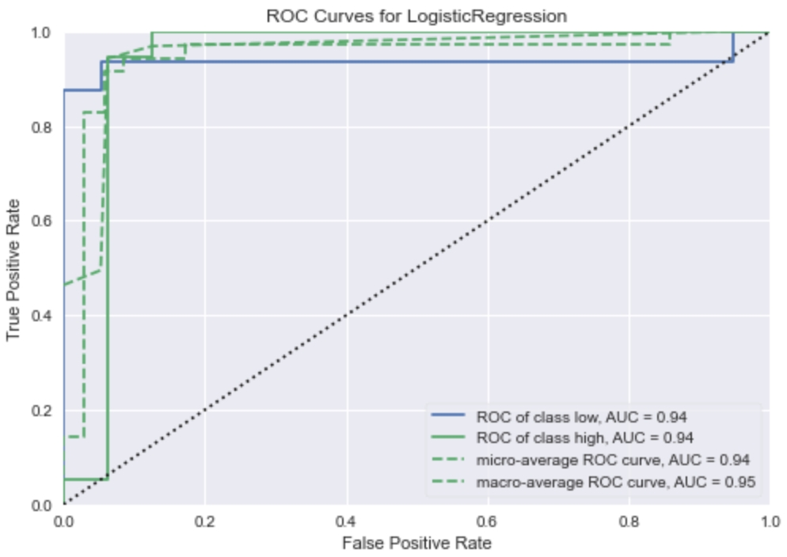
Satisfaction Prediction
What factors significantly affect my satisfaction towards a restaurant?
Logistic Regression Model
ROC AUC score obtained : 0.9375
The model shows an outstanding ROC AUC score meaning the model is able to indicate whether the restaurant will be satisfied or not excellently.

Slide 19
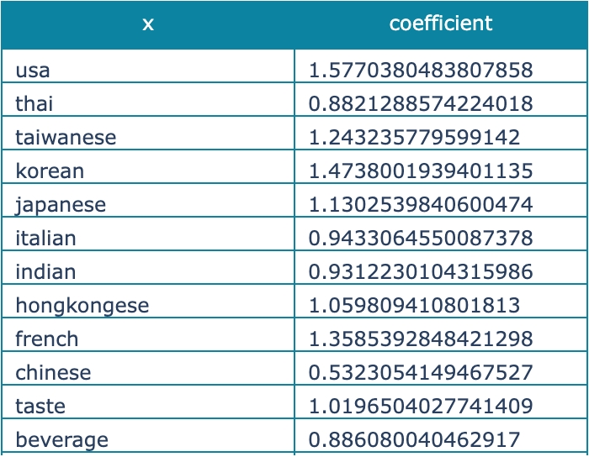
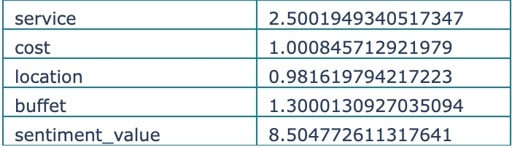
Satisfaction Prediction
What factors significantly affect my satisfaction towards a restaurant?
The coefficients obtained from the model shows that the factors that significantly affect the result are :
Sentiment value (obtained from sentiment prediction based on opinion)
Service score of the restaurant

Slide 20
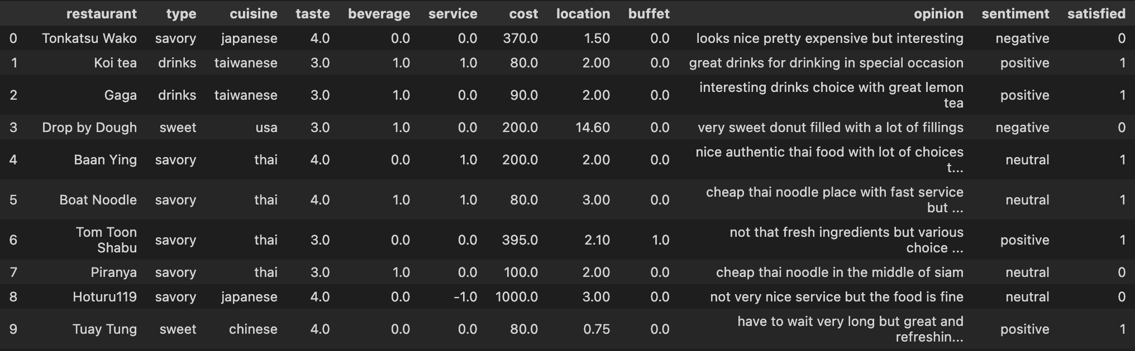
Model Evaluation
Predicting my satisfaction toward a restaurant using a new dataset
Predicted
Satisfaction
Unsatisfied
Satisfied
Satisfied
Unsatisfied
Satisfied
Satisfied
Satisfied
Unsatisfied
Unsatisfied
Satisfied
Actual
Satisfaction
Satisfied
Satisfied
Satisfied
Unsatisfied
Satisfied
Satisfied
Unsatisfied
Unsatisfied
Unsatisfied
Satisfied
Evaluation Process
Predict sentiment from the opinion
Predict satisfaction from the input data (used the predicted sentiment from NLP)
Evaluation Result
Both the models – NLP (LSTM) and logistic regression – combined can predict the satisfaction for 8 out of 10 new restaurants correctly giving the accuracy of 0.8 which is highly satisfying.

Slide 21
Conclusion and Future Research
Conclusion
Food Consumption Pattern Analysis
Japanese restaurant is the most restaurant tried while American cuisine is the most satisfied and Korean cuisine is the most unsatisfied
Higher-priced restaurants show a tendency to be more satisfactory
Keyword for positive opinion is “great” and for negative opinion is “pretty expensive”
Satisfaction Prediction
Factors that significantly impact the prediction result are sentiment (from opinion) and service score
Future Research
This model after generalization (by collecting data from large populations) can be adapted into restaurant review websites or can be used by restaurants to do self evaluation and see parts of the restaurant that can be further develop or improve. Moreover, the model can be used by people that want to start a restaurant business in order to see the market trend and implement strategy for their business.

